Slide 1
TCGA Database_DMR_Breast Cancer (Tumor_Normal Tissue)

Slide 2
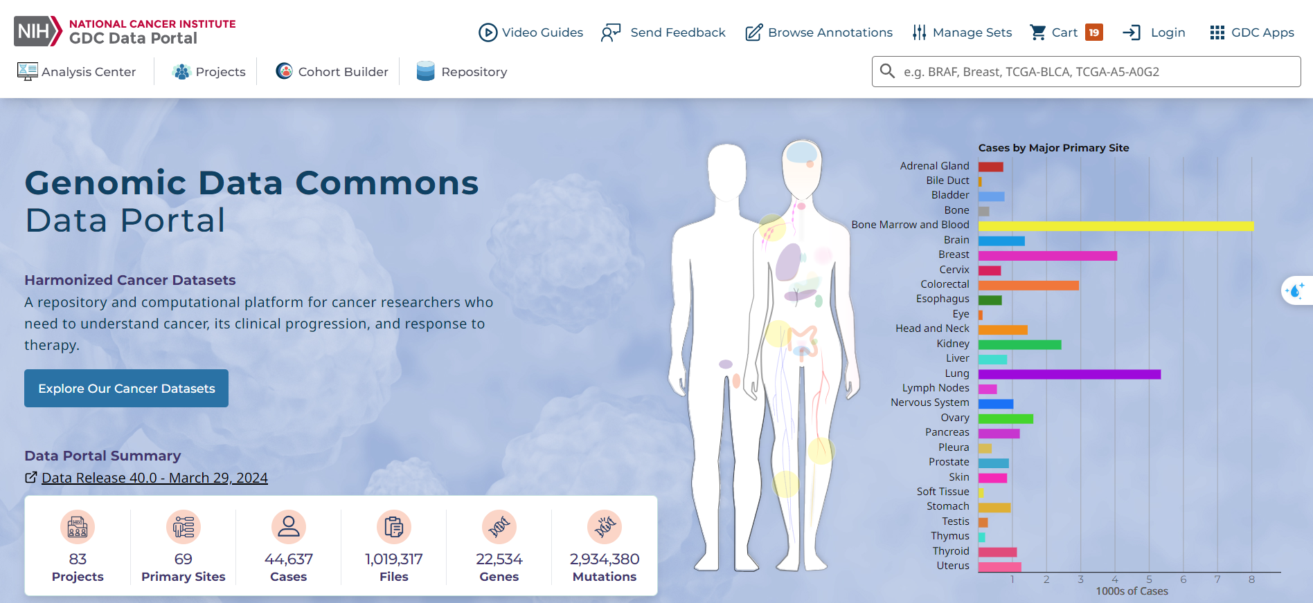
Tumor Tissue
illumina human methylation 450K: 774 case
illumina human methylation 27K: 311 case
Normal Tissue
illumina human methylation 450K: 97 case
illumina human methylation 27K: 27 case

Slide 3
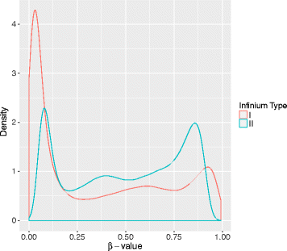
The Illumina 450K BeadChip includes two distinct probe types, Infinium I (n=135501) and Infinium II (n=350076)
β-value:
β=M/(M+U+α)
M-value, M=log₂(β/(1−β))

Slide 4
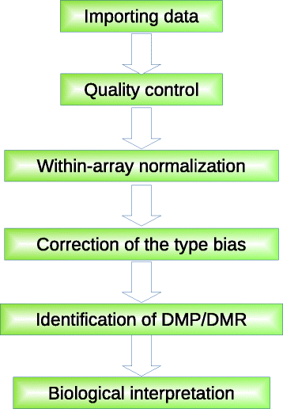

Slide 5
Import data
Raw data (*.idat): the direct output from Illumina iScan system and stores intensities for each probe
R: illuminaio package
Qualify control
First, probes displaying a high detected p-value should be filtered out (e.g. > 0.01), while such probes have a β-value of “NA” in *.txt files.
There are 850 inbuilt control probes on the 450K array.
Probes on Chromosome 23 should be filtered out to eliminate the impact of sex.
There were 4.3% of Illumina 450K probes containing a known SNP at the targeted site.
Cross-reactive probes on the Illumina 450K array

Slide 6
Within-array normalize
This step includes background correction and color bias adjustment.
Background correction: Noob and Normexp, which are based on convolution models and use out-of-band (OOB) probes intensities to measure the background (lumi R package)
Color bias adjustment: methylumi R package proposed a color bias adjustment based on smooth quantile or shift-and-scaling normalization.
Correction of the type bias
The main challenge in correcting methylation data is the probe type bias, especially due to differences between Infinium I and Infinium II probes.
Peak-based Correction (PBC): This method rescales Infinium II methylation values to match the distribution modes of Infinium I
Subset Quantile Normalization (SQN): SQN normalizes data based on the assumption that β-values of CpGs in the same biological category have similar density distributions.
Subset-quantile Within Array Normalization (SWAN): SWAN assumes that β-value distributions should be similar for probes with the same number of CpGs.
Beta Mixture Quantile normalization (BMIQ): BMIQ decomposes density profiles of Infinium I and II probes into three states and uses quantile normalization to align Infinium II to Infinium I distributions.
Regression on Correlated Probes (RCP): RCP adjusts methylation levels of Infinium II probes using quantile linear regression models of correlated pairs of nearby Infinium I and II probes.
Batch Effects Removal: It's essential to remove non-biological batch effects between samples. Principal Component Analysis (PCA) can be used for between-sample normalization to partially remove batch effects.

Slide 7

Identification of DMPs/DMRs
β-value is the default value for methylation measurement, allowing easy biological interpretation.
M-value, is used to express the degree of methylation obtained with Infinium.
Due to the heteroscedasticity of β-value, the variance of M-value across the methylation range is approximately constant, so the M-value has better statistical properties.
SQN simply considers a probe as DMP if the absolute value of the difference between β-value medians of paired samples is higher than 0.2:
Minfi package + scatterplot smoothing (LOESS)
DMRs are detected by applying various statistical techniques such as Fisher’s exact test, t-test, Wilcoxon rank sum test or different regression models.

Slide 8

Biological interpretation
sites located inside a CGI
sites located in the CGI shores (0-2k bp)
sites located in the CGI shelves (2-4k bp)
sites located in the “open sea”.
The sites are categorized as inside the promoter, inside the 5’-UTR region, inside the gene body and inside the 3’-UTR region. Then the significant DMPs can be marked with their related genes.
In Illumina 450K array, the numbers of CpGs associated with each gene ranges largely from 1 to 1299. Genes with larger numbers of probes are more likely to have significant differentially methylated CpGs.

